Slide 1
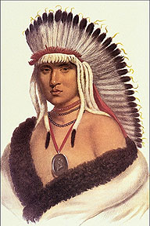
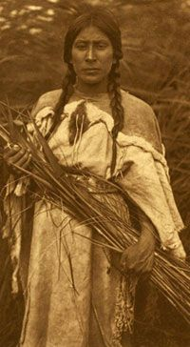
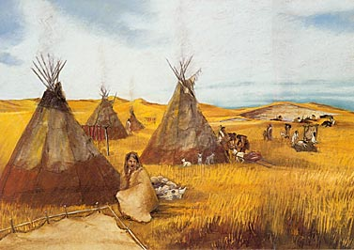
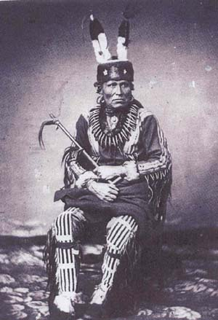
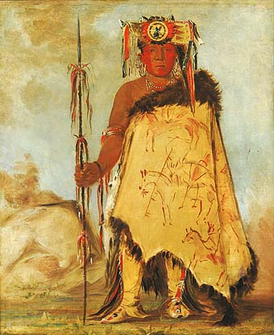
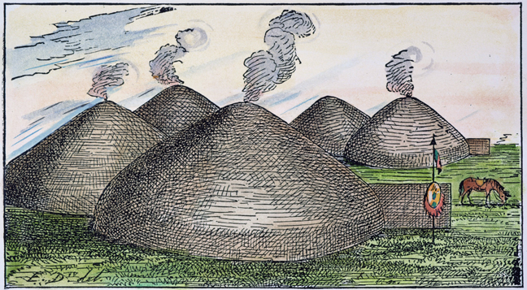
Pawnee Indians

Slide 2
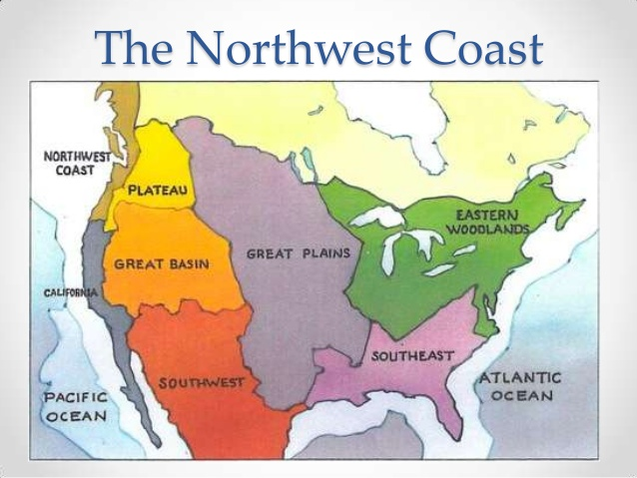
Where did they live?
Nebraska and Kansas area
Grasslands with few trees
Terrain was open, flat, dry
Cold winters with snow and possible blizzards
Hot & humid summers
Very windy- sometimes caused dust storms

Slide 3
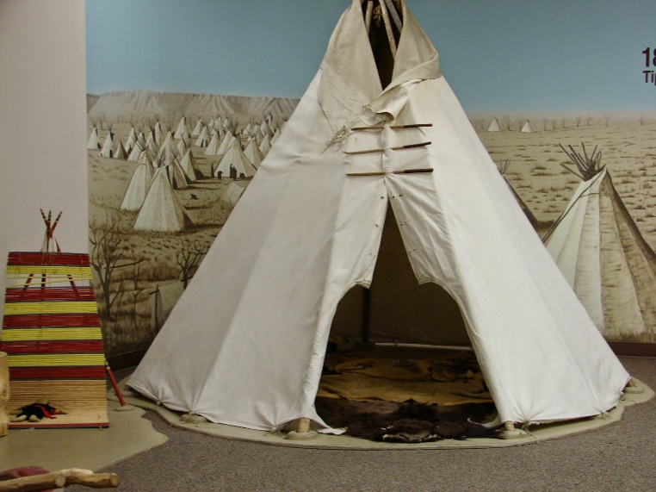
How did they live?
Round grass earthlodges constructed with logs, branches, layer of grass
As many as 30-50 people live in the same lodge
About 10-15 lodges
Hunting Season: Teepees with animal skin over wooden frame

Slide 4
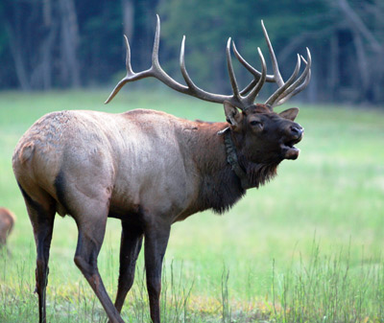
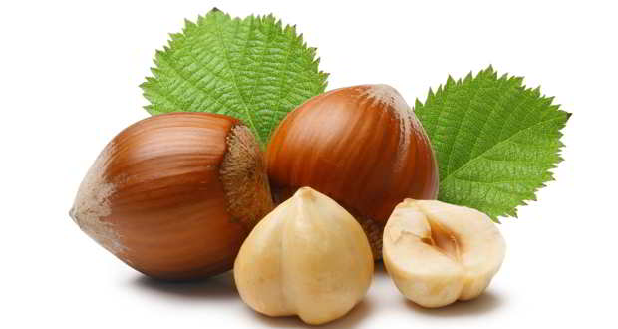
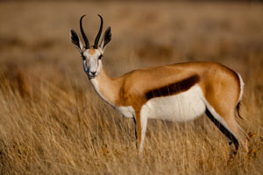
Use the land to survive.
Mostly a farming tribe
Hunted buffalo, elk, antelope
Grew corn, beans, squash, pumpkins, sunflowers
Collected plums, hazelnuts, walnuts

Slide 5
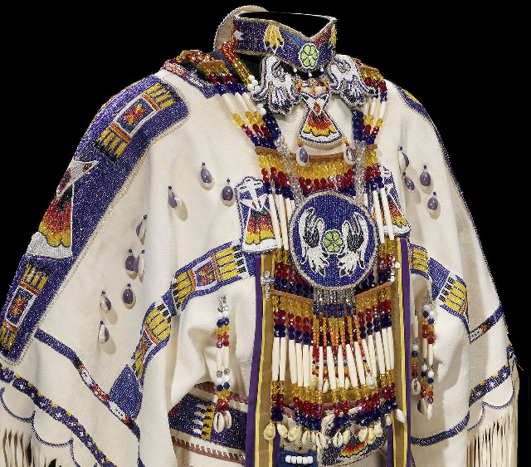
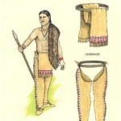
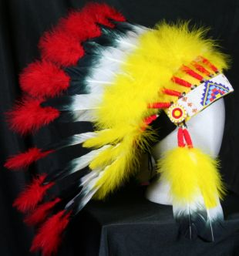
What did they wear?
Summer- otter skin moccasins, buffalo skin loin cloths
Winter- buffalo or fur robes and pants, animal skin leggings
Dresses, skirts, beaded blouse with fringe
Headdresses

Slide 6
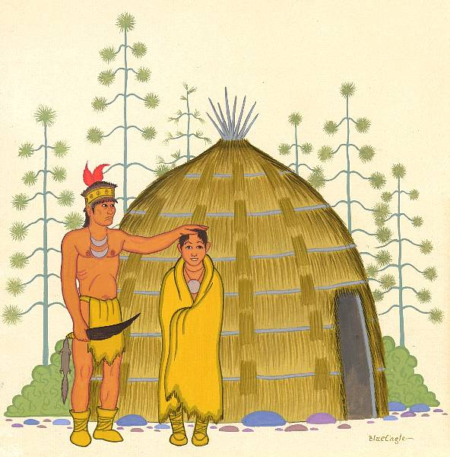
How they Spent their Time
Women did most labor- farming and gathering
Young women watched and learned
Older women watched children
Men hunted, were warriors, and medicine men / priests

Slide 7
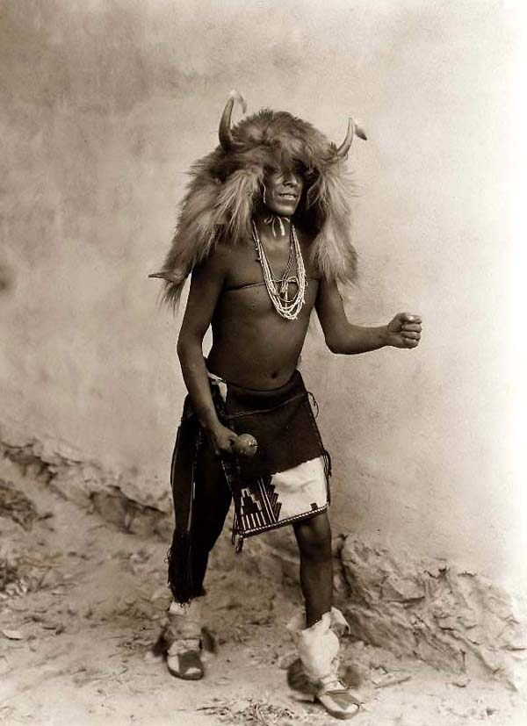
Cultures and Traditions
Headdresses were worn by men to show honor- every act of bravery earned them a black feather
Buffalo- VERY important; over 80 uses
Meat to eat
Intestines as containers
Skin to wear
Bone for tools
Skin for bedding, clothing, teepees

