Slide 2
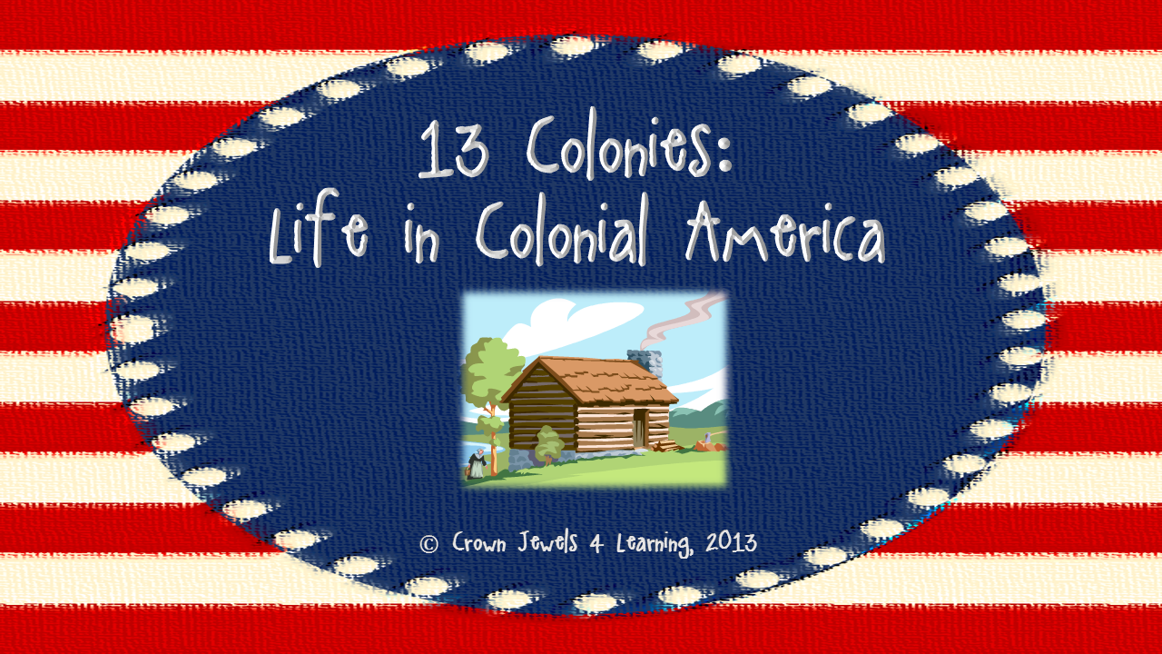
© Crown Jewels 4 Learning, 2013
Clip Art: Microsoft Office and Teacher’s Clipart

Slide 3
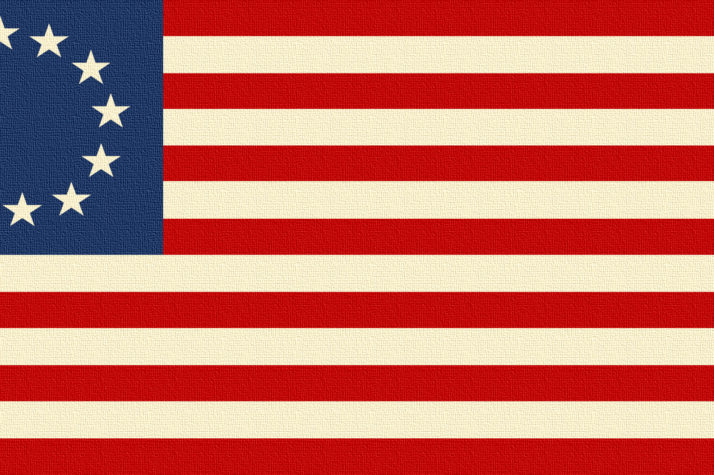
As more and more people came
to the New World, settlements
called colonies were established.
Life in each colony was affected by the
climate, geography, and people who
settled there.

Slide 4
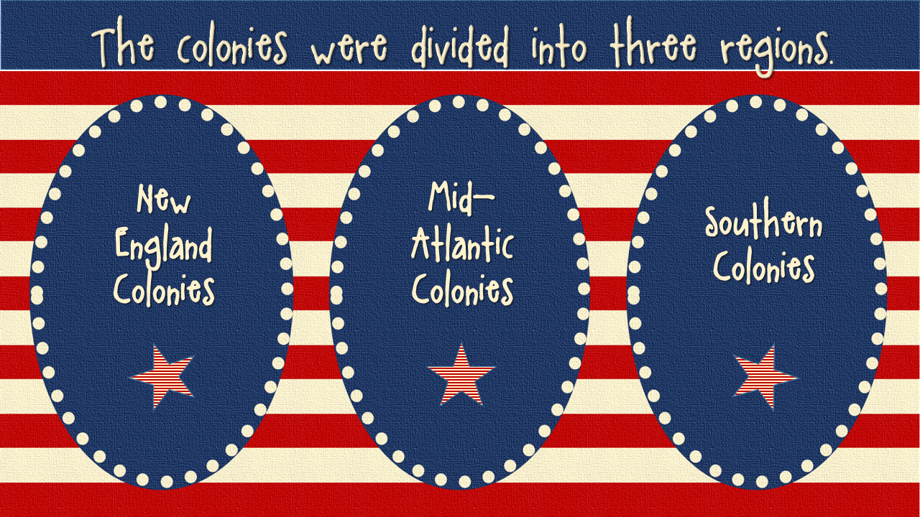
© Crown Jewels 4 Learning, 2013

Slide 5
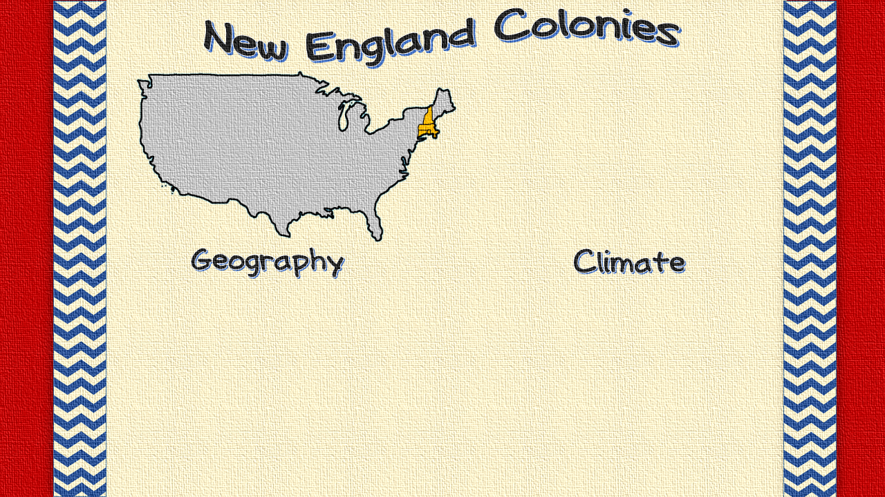
Massachusetts
Connecticut
Rhode Island
New Hampshire
© Crown Jewels 4 Learning, 2013
Physical features include:
The Appalachian Mountains
The Boston Harbor
The land was hilly, rocky and not suitable for farming.
The coastline was steep and jagged.
Winters were long and harsh for the New England colonists, and many people died because of the cold.
Summers were mild. They were warm and not too hot.

Slide 6
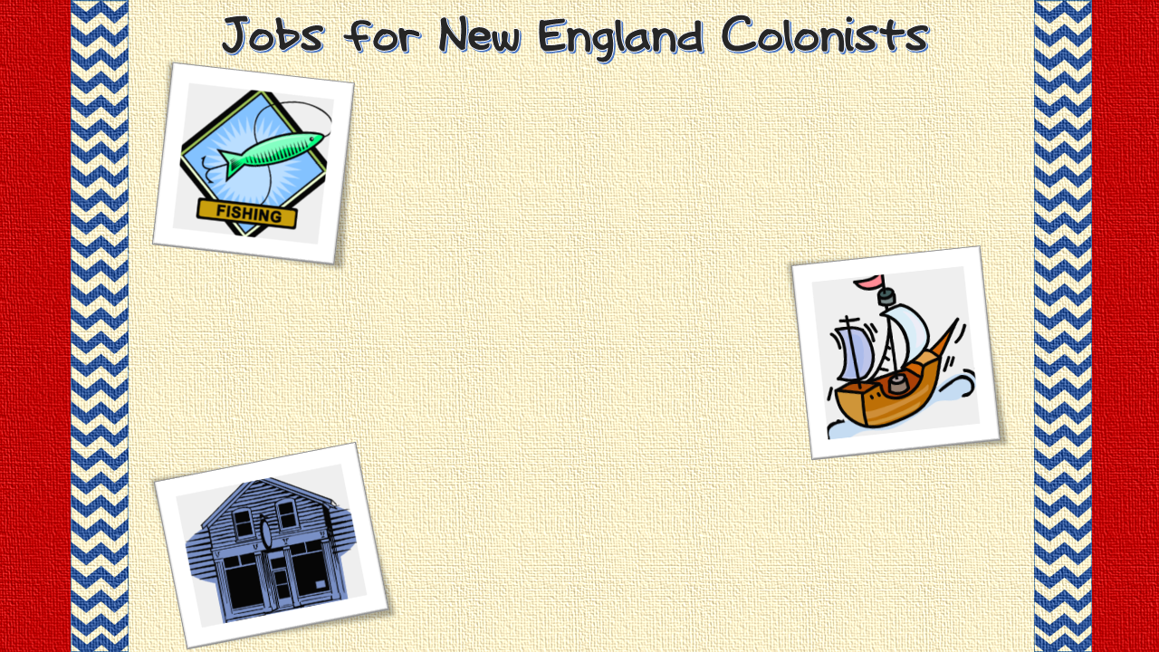
The New England colonies had access to a great coastline. The coastline of the Atlantic Ocean provided abundant fishing opportunities and jobs for the people of this region.
Fishing opened the door for other economic opportunities. Since fishermen need ships, the ship building industry boomed and became one of the most important jobs for New Englanders.
© Crown Jewels 4 Learning, 2013
Good harbors, fishing, and ship building opportunities paved the way for port cities to grow in this region. The port cities grew into trade centers, so more and more people flocked to the area.

Slide 7
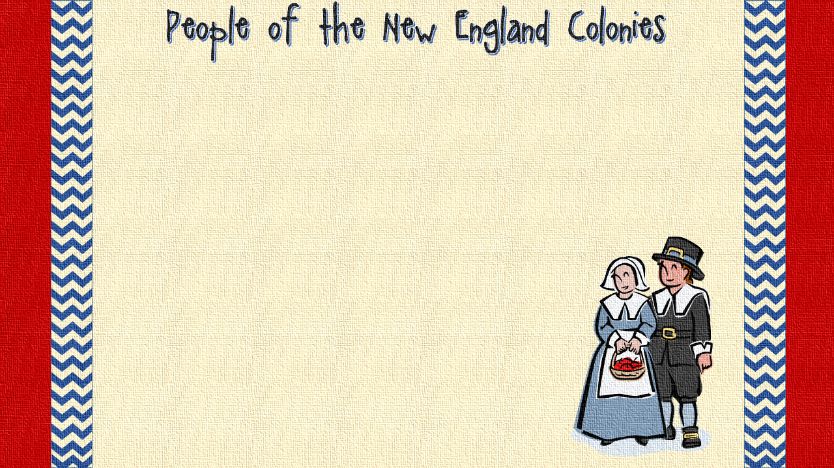
People who settled in the New England colonies were seeking religious freedom.
Puritans and Pilgrims settled here.
Many of their social gatherings were held at church.
They held town meetings to discuss political issues.
© Crown Jewels 4 Learning, 2013

