Slide 1
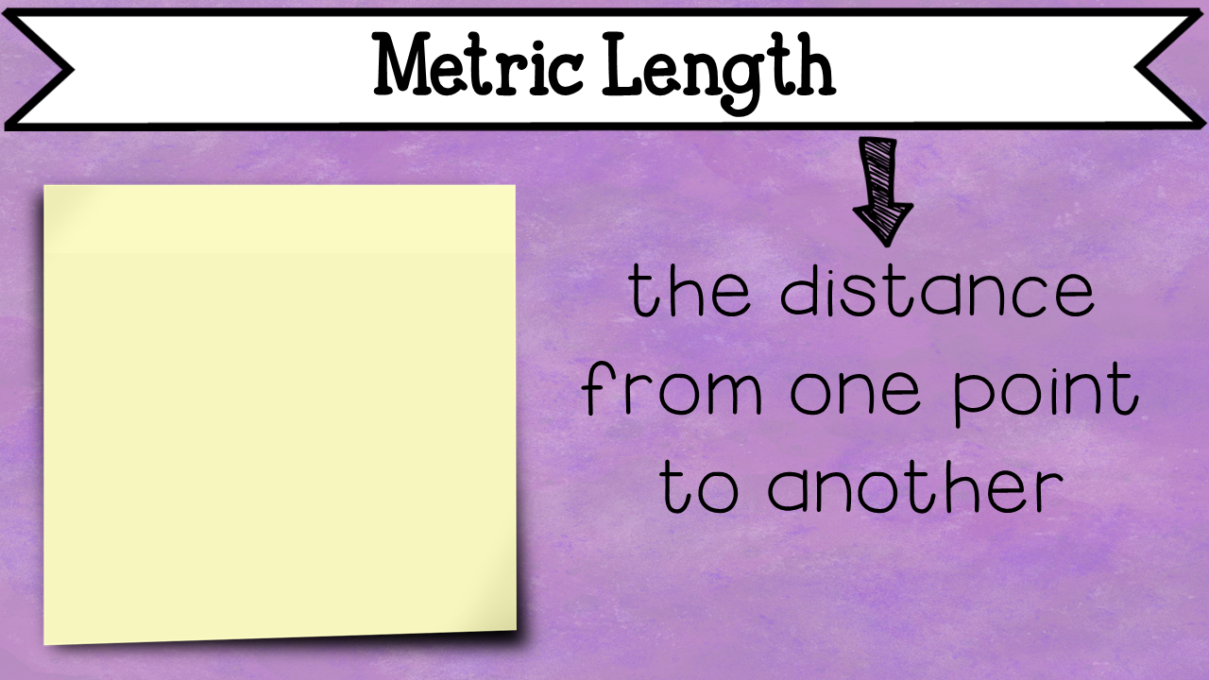
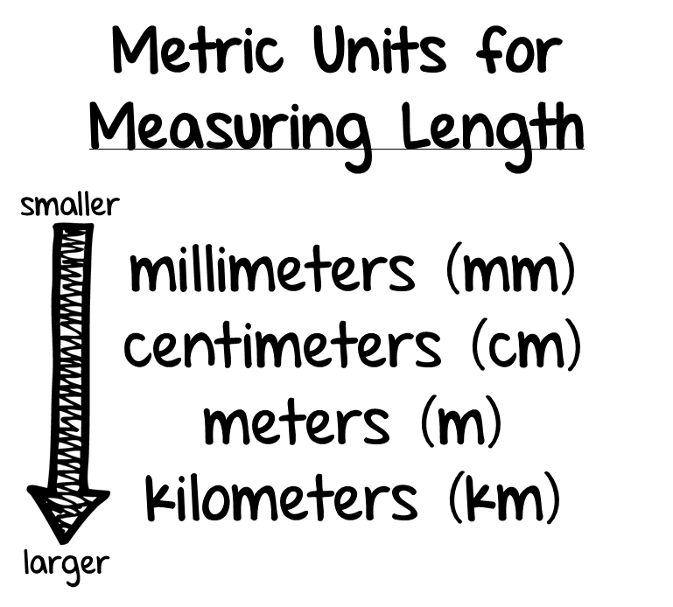

Slide 2
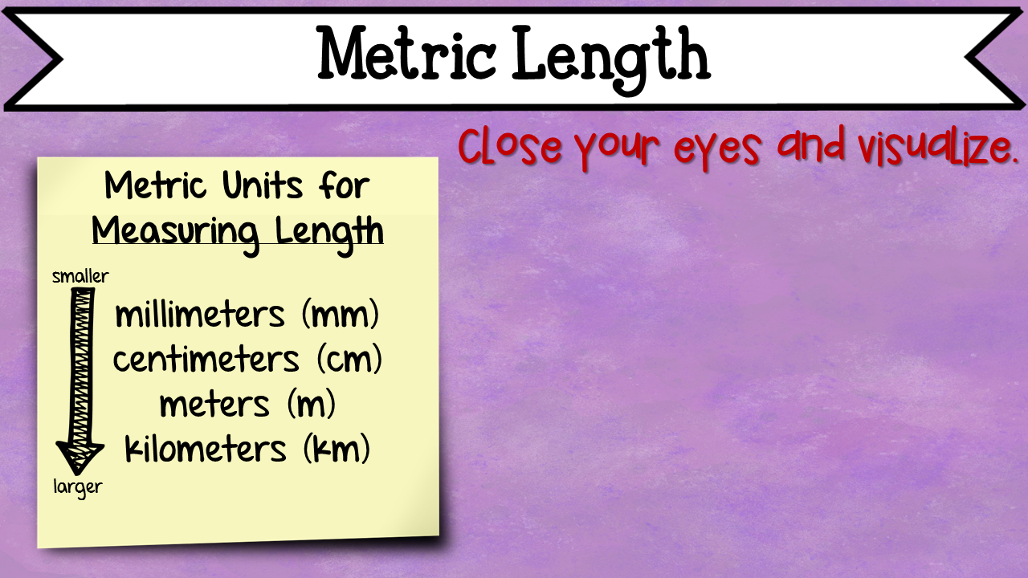
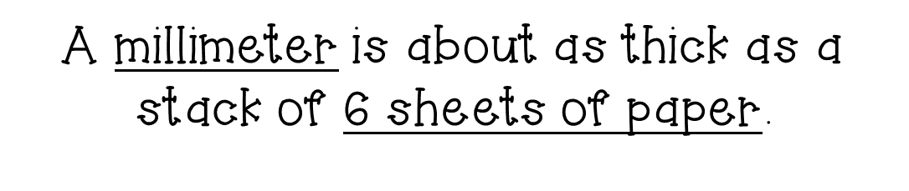
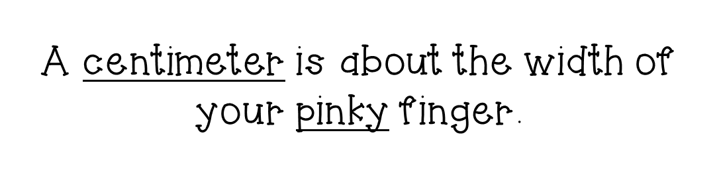
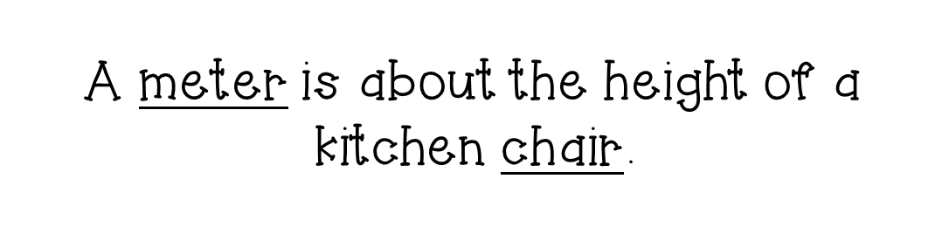
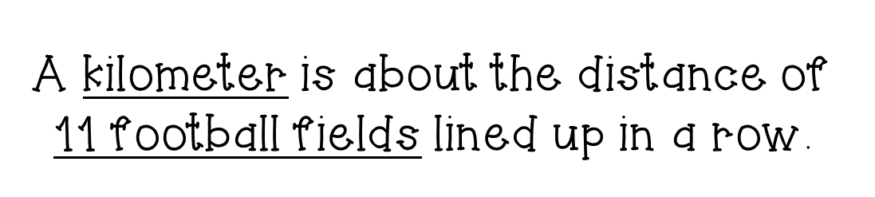

Slide 3
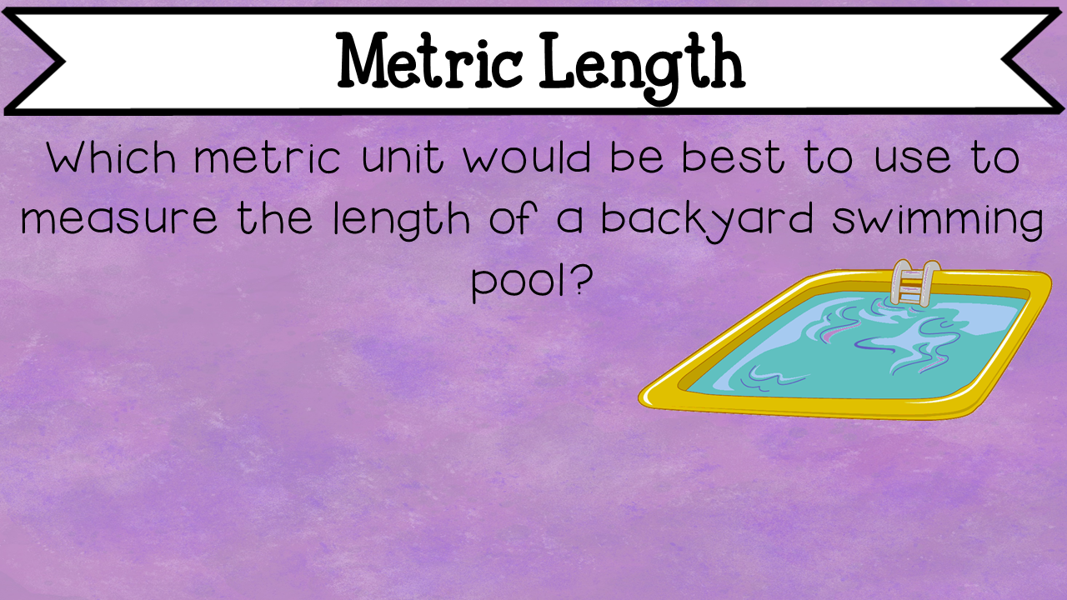



Slide 4
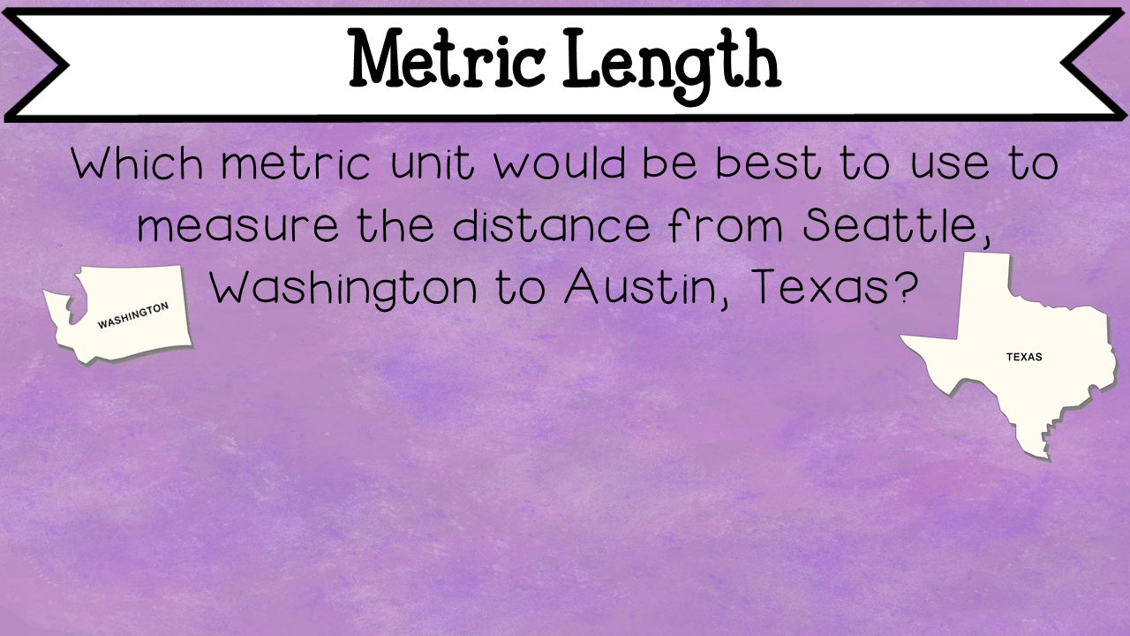



Slide 5
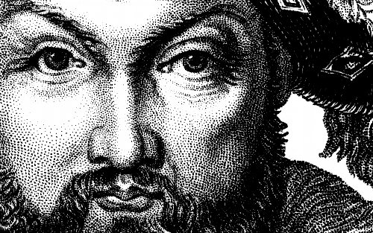
The Story of King Henry

Slide 6
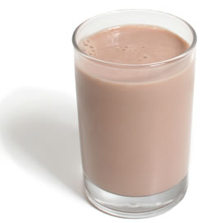
Once upon a time in a faraway land there lived a king who loved chocolate milk. His name was King Henry.

Slide 7
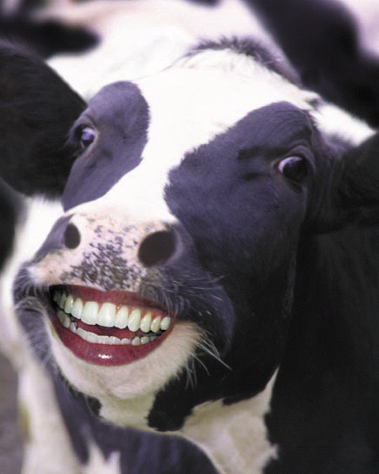
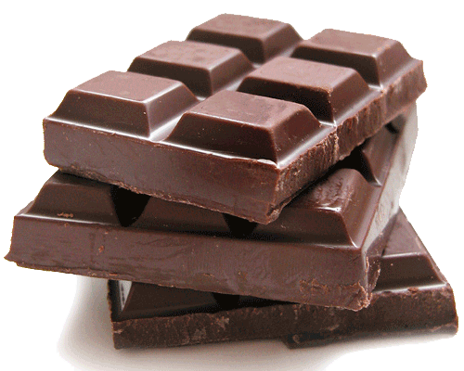
Throughout his kingdom, King Henry made sure that all of the cows were fed great supplies of chocolate to continue to provide him with his beloved chocolate milk drink.

Slide 8
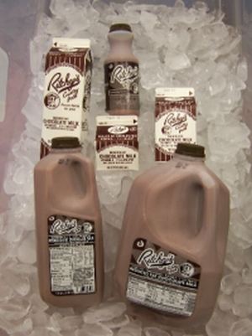
King Henry drank chocolate milk with his breakfast. He drank chocolate milk with his lunch. He drank chocolate milk with his dinner. He even drank chocolate milk for his bedtime snack. King Henry drank chocolate milk by the liters!

Slide 9
King Henry was so obsessed with his chocolate milk that he wrote a decree making it illegal for anyone to drink chocolate milk, except for himself. King Henry’s wife was furious with his decision to create such a law so she grabbed her kids to go stay with her mother. The guards were upset with the King too, so they left the castle to find a new king to take care of.

Slide 10
Soon, King Henry was all alone….BUT, he had his chocolate milk. Depressed, he drank more chocolate milk than ever. And one evening, he overdosed on chocolate milk. His body couldn’t process all of the chocolate.
Sadly,
KING Henry died UNHAPPILY drinking Chocolate Milk.

Slide 11
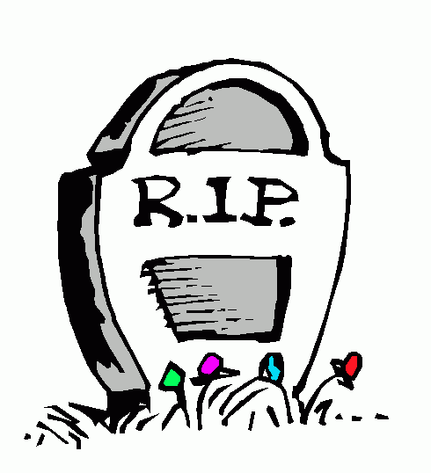
King Henry died UNHAPPILY Drinking chocolate milk.
kilo hecto deka UNIT deci centi milli
However, the metric system remembers him every year when students learn math. His RIP statement is King Henry died unhappy drinking chocolate milk. This is how you remember the prefixes for metric measurement and how to order the units from greatest to smallest.

Slide 12
