Slide 2
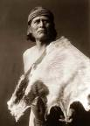
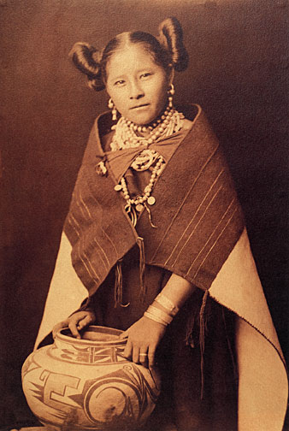
Hopi
Let’s learn about their culture, clothing, food, home, beliefs, & lots more…

Slide 3
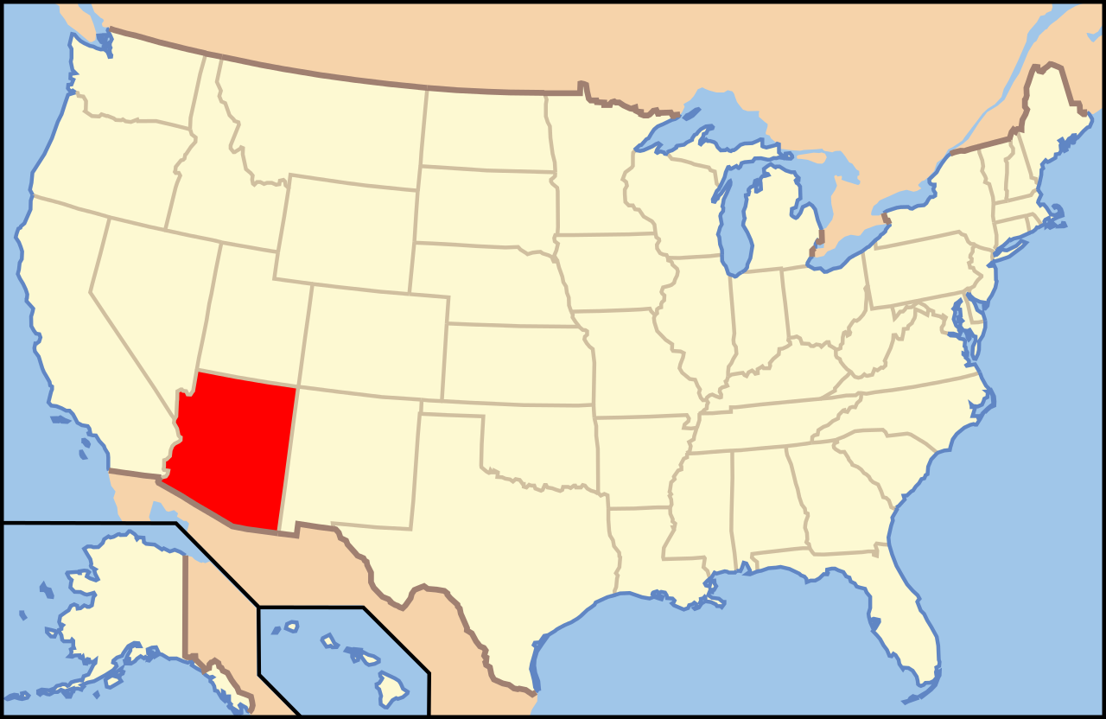
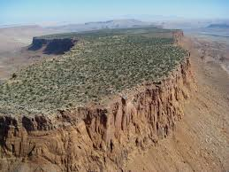
Where did they live?
Southwestern region
of the United States
Present day Arizona
Land had flat hills called mesas
Hot and dry climate
May have gone months with very little rain
Hot days, cold nights

Slide 4
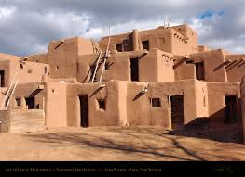
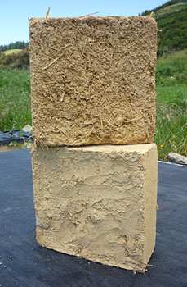
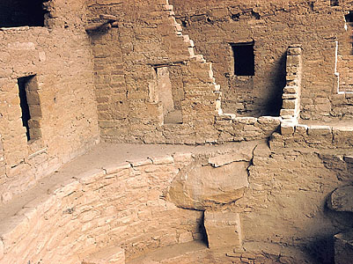
Home/Shelter
Lived in the desert.
Houses called pueblos, made from adobe bricks.
Adobe is made from baked mud, stones, and straw.
Built on the side of mesas (step flat topped cliffs). Cliff-dweller
Resemble apartment buildings- several stories high.
Pueblos had flat roofs with openings in them.
People used ladders to climb up and removed them at night for protection.

Slide 5
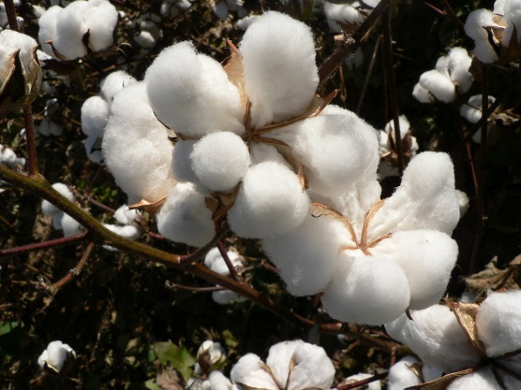
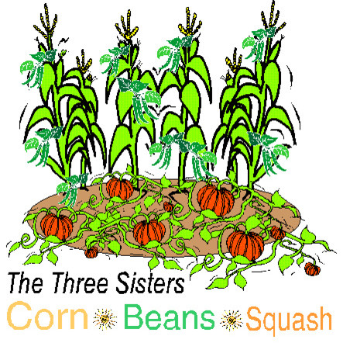
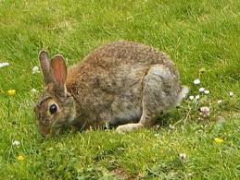
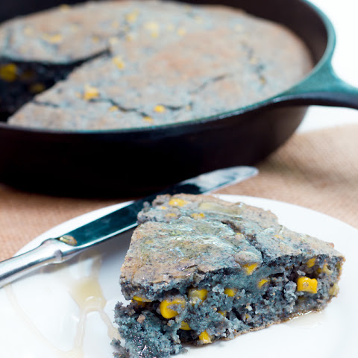
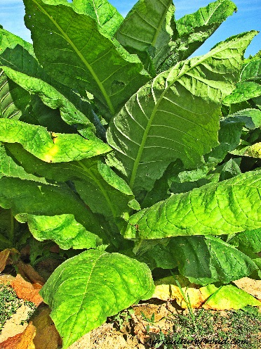
What did they eat?
Farming: corn (maize), squash, beans, pumpkins, cotton, and tobacco.
Men hunted deer, antelope, and other small game.
Women gathered nuts and berries.
Favorite meal was cornbread, baked beans, and soup.

Slide 6
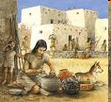
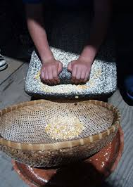
CULTURE
Men- The men had to govern homes, hunt for deer and antelopes, and tend crops.
The Hopi men didn’t have a lot of tasks as the women, but men did have harder jobs.
Women- The women had to care and own property, cook, gather nuts, fruits, and herbs, and grind corn and then put them in containers, so that everyone had containers with cornmeal in their houses- for when there were droughts.

Slide 7
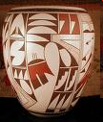
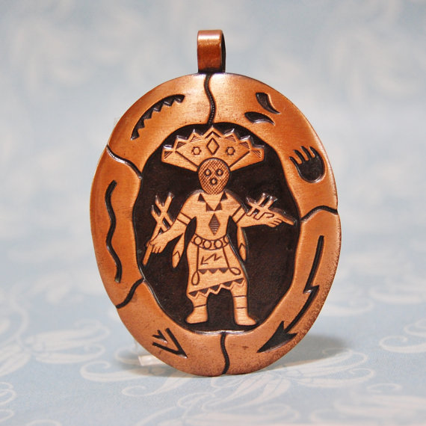
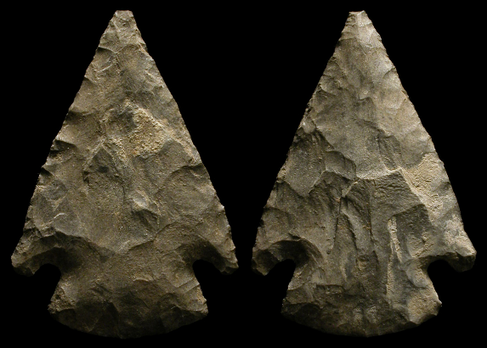
Trade
The Hopi tribe traded their things for:
Copper bells
Arrowheads
Shells
Salt
Their most important trade item is salt because it was used to flavor food, preserve food for droughts, and heal others.

Slide 8
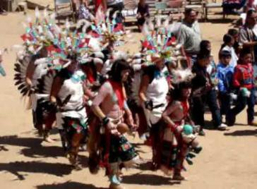
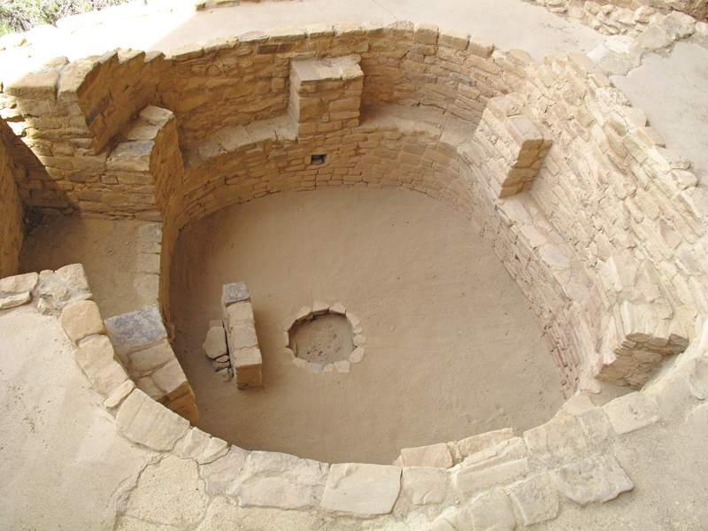
Beliefs/Traditions
Subtribe of the Pueblo people. “Pueblo” is Spanish for “town”.
“Hopi” means “peaceful” or “wise”. They are known for their peaceful relations with others.
Due to lack of rain, often did rain dances.
The Hopi tribe believed in gods of the sun, rain, and earth. Their beliefs of the gods were that the gods sent messages and went into their bodies when they began to dance.
They held ceremonies that lasted at least 8 days, sometimes even longer, in kivas.
The ceremonies were focused on weather and farming; a ceremony led to a good harvest.

Slide 9
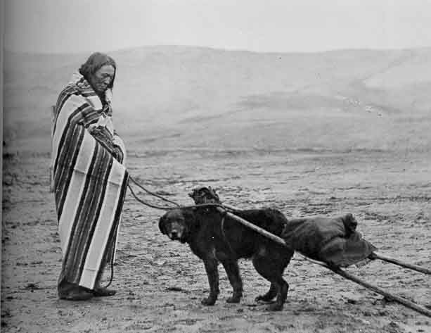
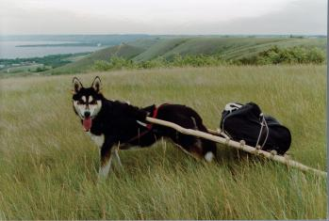
TRANSPORTATION
The Hopi rarely traveled by river, they usually traveled by walking. They didn’t have horses at the time, so they used dogs instead. They put gears on the dogs called “travois” so that they could carry heavy loads.

Slide 10
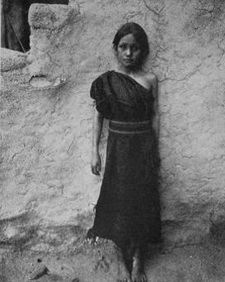
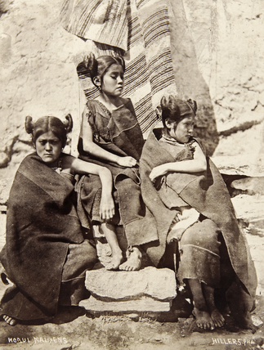
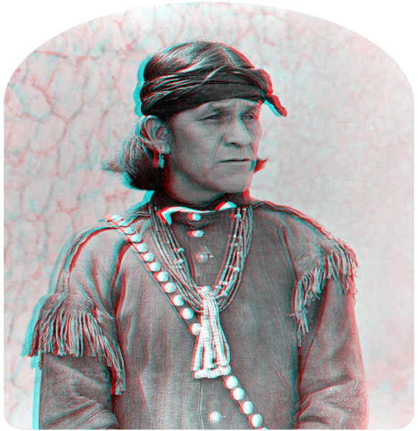
Clothing
Women- knee-length dresses (Mantas), it was fastened at the shoulder, leaving the left shoulder bare.
Men- breechcloths/short kilts (men skirts), wore cloth headbands around forehead, hair was in the style of homsoma.
Both wore beaded necklaces.
They would wear moccasins.
Clothing was made from cotton, animal fibers, animal skins

Slide 11
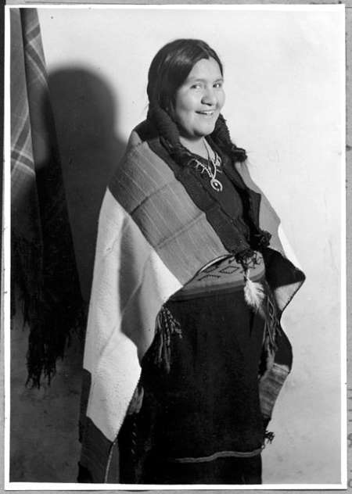
Women
Married women would have their hair in 2 long pigtails
Unmarried women would have their hair in elaborate butterfly whorls.

