Slide 1
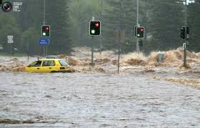
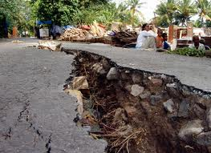
The Role of Technology and
Human Interventions
In Destructive and
Constructive Processes

Slide 2
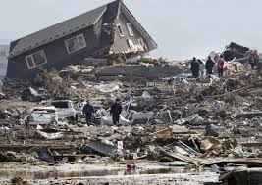
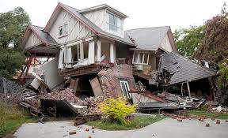
Earthquakes can be dangerous!
Scientists use special tools
to study earthquakes so humans
can be educated about earthquakes
and change the effects they have on
Earth’s structures.

Slide 3
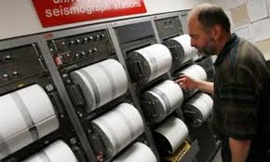
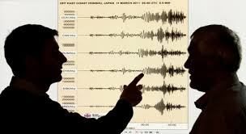
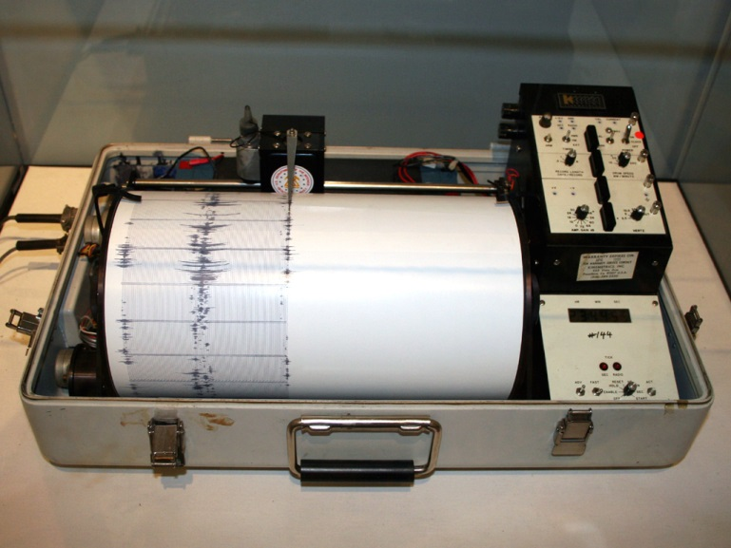
Scientists, who study earthquakes
are called .
seismologists
Seismologists use a
machine called a
to study earthquakes.
seismograph

Slide 4
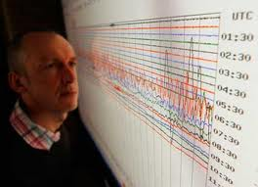
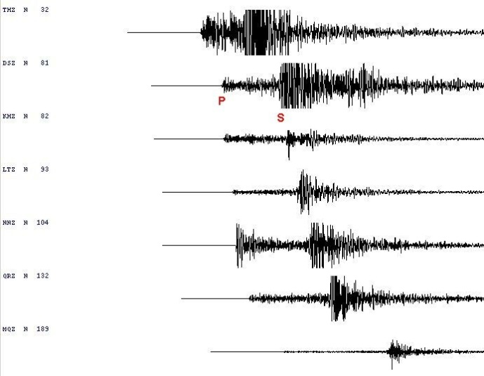
Seismographs
record movements
in the Earth’s crust.
Click this link to see a live seismograph in action
for the San Francisco Bay Area.
http://abclocal.go.com/kgo/livenow?id=8570860
seismograph
A
helps us learn:
How strong was the earthquake?
When did it happen?
How long did it last?

Slide 5
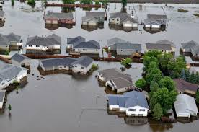
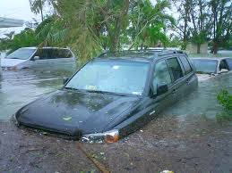
Like earthquakes, floods are a
natural process that can be
costly and destructive.

Slide 6
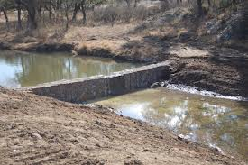
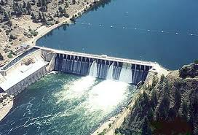
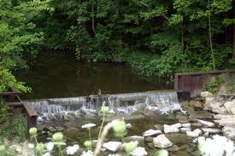
How can humans control flooding?
Dams can be built.
Dams hold back water during
heavy rainfall. This water can
then be released slowly. This
can prevent flooding.

Slide 7
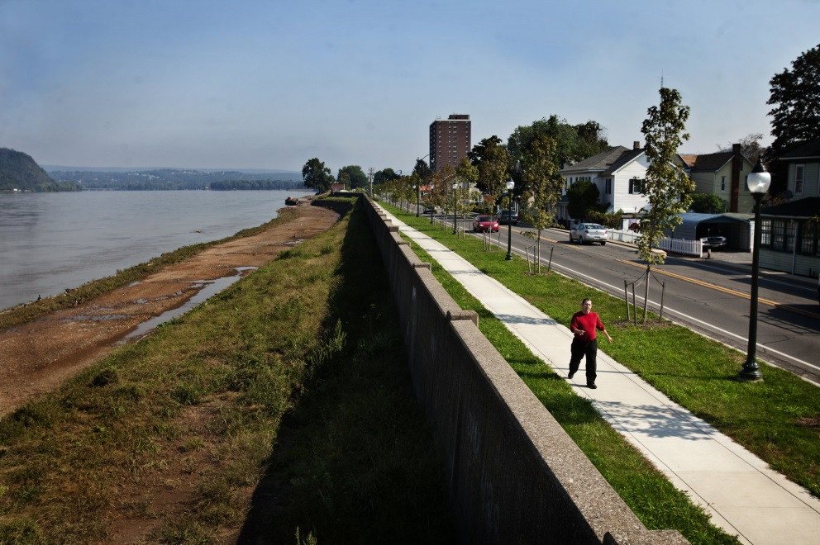
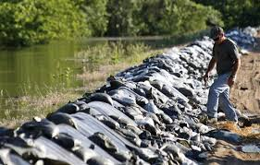
Levees can also be built to help
prevent flooding.
A levee is a wall of earth or concrete
built along the banks of a waterway.
Levees keep rising floodwaters
contained.
Click this link to see a simulation of how the failure
of the levees caused catastrophic damage during Hurricane Katrina.
http://www.nola.com/katrina/graphics/flashflood.swf

Slide 8
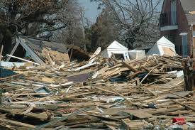
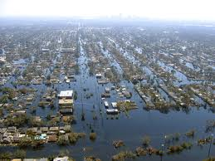
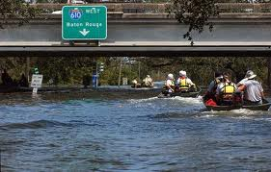
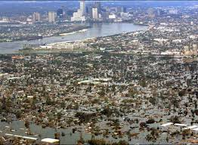
Aftermath of Hurricane Katrina
2005

Slide 9
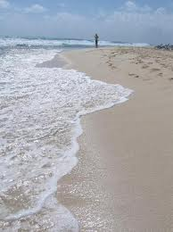
An area that people are
constantly working to keep
from eroding is beaches.
Waves wash ashore
and take the sand
back out with it!
This is not good
for two reasons:
Sand moves away
from the beaches.
2. Sand that is carried out to
the water can fill up channels,
which become so shallow, that
boats can’t pass through.

Slide 10
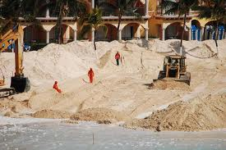
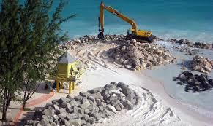
Beach Restoration is the process
of replacing sand on the
beaches.
This only solves the problem temporarily.
Erosion continues to take place.

Slide 11
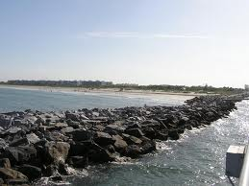
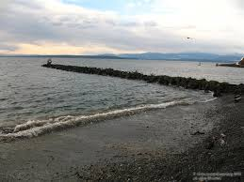
jetties
So people also build to
prevent the loss of beach sand.
Jetties
are wall-like structures that stick out
into the oceans. A jetty traps sand and small rocks on the beach.

Slide 12
Let’s Review!
What is a scientist called who studies
earthquakes?
seismologists
seismograph
record movements
in the Earth’s crust
2. What does a do?
3. What are two ways that floods can be
prevented?
building dams and levees (explain each)
4. What can happen to the sand on beaches?
The waves can wash the sand out to “sea.”
5. What is beach restoration?
the process of replacing sand on the beaches
jetty
6. What is a , and how does it help the beach?
Jetties are wall-like structures that stick out into the
ocean. They trap sand and small rocks on the beaches.

